Slide 1

Sentiment Analysis
Aishwarya Sivacoumar
200543267

Slide 2

Introduction
Sentiment analysis, also known as opinion mining, is a field within natural language processing (NLP) that focuses on determining the emotional tone behind a body of text. It involves classifying text as positive, negative, or neutral, and is commonly used to analyze customer reviews, social media posts, and other forms of user-generated content. The goal of sentiment analysis is to understand the sentiments expressed by individuals and to gain insights into public opinion, customer satisfaction, and other relevant metrics.
Applications of Sentiment Analysis
Customer Feedback: Analyzing reviews and feedback to understand customer satisfaction and identify areas for improvement.
Market Research: Gauging public opinion about products, services, or brands.
Social Media Monitoring: Tracking sentiments around specific topics, events, or entities on social media platforms.
Financial Market Prediction: Using sentiment trends to predict market movements and investment opportunities.

Slide 3

Dataset Overview
The dataset from Kaggle, titled "Social Media Sentiments Analysis Dataset," provides a comprehensive collection of social media posts annotated with sentiment labels. This dataset is ideal for training machine learning models to perform sentiment analysis and for conducting exploratory data analysis (EDA) to understand the sentiment distribution and patterns within the data.
DataSet Link: https://www.kaggle.com/datasets/kashishparmar02/social-media-sentiments-analysis-dataset
User: The username or ID of the person who made the post.
Timestamp: The date and time when the post was created.
Content/Text: The actual text of the social media post.
Platform: The social media platform where the post was published.
Sentiment: The sentiment label assigned to the post. This can be categorical (e.g., positive, negative, neutral) or numerical.
Country (optional): The geographical location from where the post was made.
Hashtags (optional): Hashtags used in the post.
Likes (optional): The number of likes the post received.
Retweets/Shares (optional): The number of times the post was retweeted or shared.

Slide 4

About Python Process
The process of sentiment analysis using the "Social Media Sentiments Analysis Dataset" involves several key steps in Python. We start by loading the dataset and cleaning the text data through preprocessing steps like removing URLs, special characters, and stopwords. Next, we perform exploratory data analysis (EDA) to visualize sentiment distributions and common words. Using the TF-IDF vectorizer, we convert the text into numerical features. A logistic regression model is then trained and evaluated on the data, using metrics such as accuracy and a confusion matrix to assess performance. This structured approach helps us effectively analyze and understand sentiments in social media posts.

Slide 5
OBJECTIVE
Understand the data
Initial Insights
Data Preparation
Visualization
Load the "Social Media Sentiments Analysis Dataset" from Kaggle and familiarize yourself with its structure and contents.
Analyze the sentiment distribution within the dataset to gain preliminary insights into public opinions.
Transform the cleaned text data into numerical features using TF-IDF. Train a machine learning model to classify sentiment as positive, negative or neutral.
Use metrics like accuracy and confusion matrices to evaluate and visualize the model’s performance. Create visual representations such as work clouds to highlight commen themes within the sentiments

Slide 6
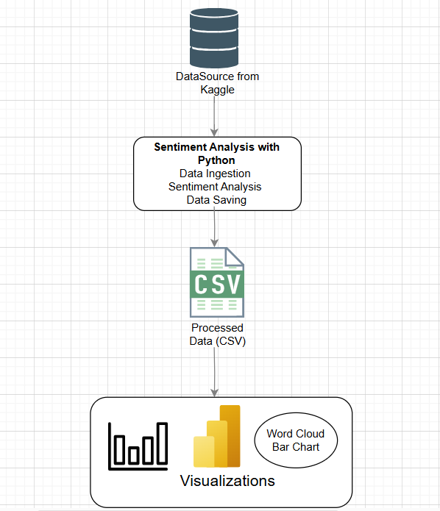
Architecture

Slide 7
Explanation of Architecture
Data Acquisition:
Collect raw text data from sources like CSV files, databases, or APIs.
Data Ingestion:
Load the text data into a Jupyter Notebook for processing.
Sentiment Analysis:
Use Python libraries (e.g., TextBlob) to analyze the sentiment of each text entry, calculating sentiment scores.
Data Storage:
Save the analyzed results, including sentiment scores, into a structured format like a CSV or Excel file.
Visualization:
Import the processed data into Power BI to create visualizations such as word clouds, bar charts, and histograms.
Insight Generation:
Review the visualizations to gain insights into sentiment trends and patterns, helping to understand overall sentiment and areas for improvement.

Slide 8
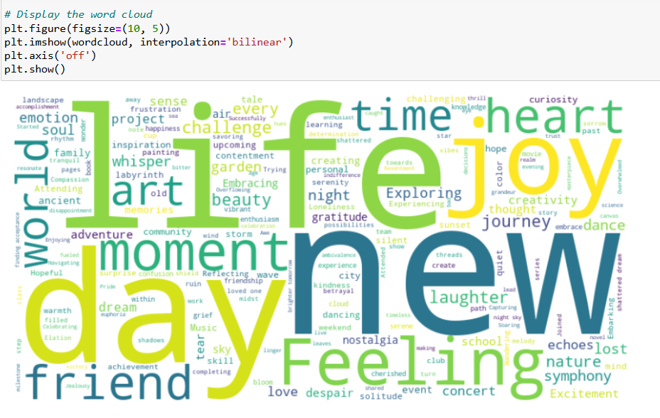
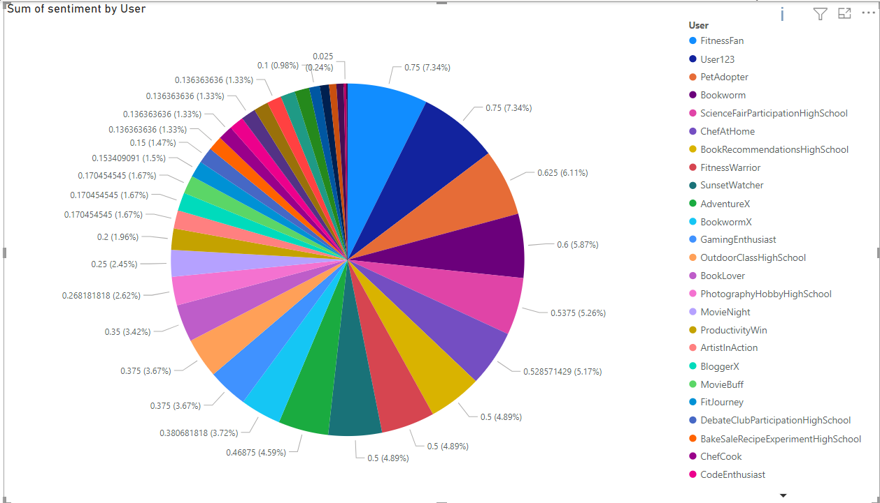
Screenshots

Slide 9

Scope and Design
This sentiment analysis solution aims to assess and interpret the sentiment expressed in textual data and present the findings through visualizations. The process starts with gathering data from sources such as CSV files, databases, or APIs. Using Jupyter Notebook, the data is ingested and processed with Python libraries, like TextBlob, to perform sentiment analysis. The analyzed results, including sentiment scores, are then saved in a structured format such as CSV or Excel. These results are imported into Power BI, where they are visualized through various charts—word clouds to display prominent terms, bar charts to show sentiment distribution, and histograms to represent sentiment score ranges. The design ensures a seamless flow from data collection to insightful visualization, facilitating a comprehensive analysis of sentiment trends.

Slide 10
CONCLUSION
The sentiment analysis performed using TextBlob effectively categorizes textual data into positive, negative, and neutral sentiments, providing valuable insights into the overall sentiment trends. Power BI's visualizations, including word clouds, bar charts, and histograms, enable a clear interpretation of these trends and highlight key themes and patterns within the data. While TextBlob offers a robust baseline for sentiment analysis, incorporating advanced models or additional preprocessing could enhance accuracy. The solution demonstrates its effectiveness in analyzing and visualizing sentiment, making it scalable for larger datasets and adaptable for real-time analysis. The insights gained from this analysis can drive informed decisions and improvements based on sentiment trends and feedback.

Slide 11

Thank You

